Slide 1
Static and Dynamic Loading:-
To load a process into the main memory is done by a loader. There are two different types of loading :
Static loading:- loading the entire program into a fixed address. It requires more memory space.
Dynamic loading:- The entire program and all data of a process must be in physical memory for the process to execute. So, the size of a process is limited to the size of physical memory. To gain proper memory utilization, dynamic loading is used. In dynamic loading, a routine is not loaded until it is called. All routines are residing on disk in a relocatable load format. One of the advantages of dynamic loading is that unused routine is never loaded. This loading is useful when a large amount of code is needed to handle it efficiently.

Slide 2
Static and Dynamic linking:
To perform a linking task a linker is used. A linker is a program that takes one or more object files generated by a compiler and combines them into a single executable file.
Static linking: In static linking, the linker combines all necessary program modules into a single executable program. So there is no runtime dependency. Some operating systems support only static linking, in which system language libraries are treated like any other object module.
Dynamic linking: The basic concept of dynamic linking is similar to dynamic loading. In dynamic linking, “Stub” is included for each appropriate library routine reference. A stub is a small piece of code. When the stub is executed, it checks whether the needed routine is already in memory or not. If not available then the program loads the routine into memory.

Slide 3
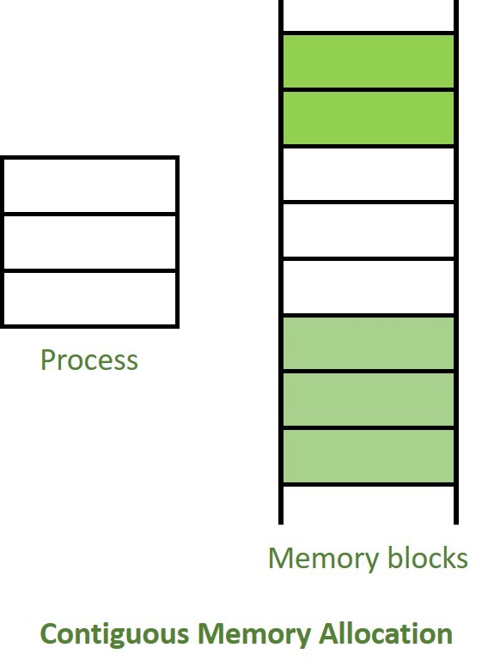
Contiguous Memory Allocation :
The main memory should oblige both the operating system and the different client processes. Therefore, the allocation of memory becomes an important task in the operating system. The memory is usually divided into two partitions: one for the resident operating system and one for the user processes. We normally need several user processes to reside in memory simultaneously. Therefore, we need to consider how to allocate available memory to the processes that are in the input queue waiting to be brought into memory. In adjacent memory allotment, each process is contained in a single contiguous segment of memory.

Slide 4
Fragmentation:
Fragmentation is defined as when the process is loaded and removed after execution from memory, it creates a small free hole. These holes can not be assigned to new processes because holes are not combined or do not fulfill the memory requirement of the process. To achieve a degree of multiprogramming, we must reduce the waste of memory or fragmentation problems. In the operating systems two types of fragmentation:

Slide 5
Internal fragmentation:
Internal fragmentation occurs when memory blocks are allocated to the process more than their requested size. Due to this some unused space is leftover and creates an internal fragmentation problem.
Example: Suppose there is a fixed partitioning is used for memory allocation and the different size of block 3MB, 6MB, and 7MB space in memory. Now a new process p4 of size 2MB comes and demand for the block of memory. It gets a memory block of 3MB but 1MB block memory is a waste, and it can not be allocated to other processes too. This is called internal fragmentation.

Slide 6
External fragmentation:
In external fragmentation, we have a free memory block, but we can not assign it to process because blocks are not contiguous.
Example: Suppose (consider above example) three process p1, p2, p3 comes with size 2MB, 4MB, and 7MB respectively. Now they get memory blocks of size 3MB, 6MB, and 7MB allocated respectively. After allocating process p1 process and p2 process left 1MB and 2MB. Suppose a new process p4 comes and demands a 3MB block of memory, which is available, but we can not assign it because free memory space is not contiguous. This is called external fragmentation.

Slide 7
Paging:
Paging is a memory management scheme that eliminates the need for contiguous allocation of physical memory. This scheme permits the physical address space of a process to be non-contiguous.
Logical Address or Virtual Address (represented in bits): An address generated by the CPU
Logical Address Space or Virtual Address Space (represented in words or bytes): The set of all logical addresses generated by a program
Physical Address (represented in bits): An address actually available on a memory unit
Physical Address Space (represented in words or bytes): The set of all physical addresses corresponding to the logical addresses

Slide 8
Example:
If Logical Address = 31 bits, then Logical Address Space = 231 words = 2 G words (1 G = 230)
If Logical Address Space = 128 M words = 27 * 220 words, then Logical Address = log2 227 = 27 bits
If Physical Address = 22 bits, then Physical Address Space = 222 words = 4 M words (1 M = 220)
If Physical Address Space = 16 M words = 24 * 220 words, then Physical Address = log2 224 = 24 bits
The mapping from virtual to physical address is done by the memory management unit (MMU) which is a hardware device and this mapping is known as the paging technique.
The Physical Address Space is conceptually divided into several fixed-size blocks, called frames.
The Logical Address Space is also split into fixed-size blocks, called pages.
Page Size = Frame Size

Slide 9
Segmentation:-
Segmentation is a technique that eliminates the requirements of contiguous allocation of main memory. In this, the main memory is divided into variable-size blocks of physical memory called segments. It is based on the way the programmer follows to structure their programs. With segmented memory allocation, each job is divided into several segments of different sizes, one for each module. Functions, subroutines, stack, array, etc., are examples of such modules.

Slide 10
A program segment contains the program's main function, utility functions, data structures, and so on. The operating system maintains a segment map table for every process and a list of free memory blocks along with segment numbers, their size and corresponding memory locations in main memory. For each segment, the table stores the starting address of the segment and the length of the segment. A reference to a memory location includes a value that identifies a segment and an offset.

Slide 11
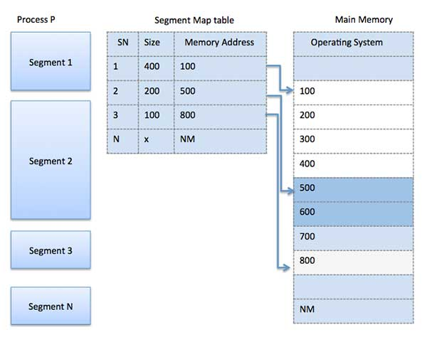

Slide 12
Virtual Memory:-
A computer can address more memory than the amount physically installed on the system. This extra memory is actually called virtual memory and it is a section of a hard disk that's set up to emulate the computer's RAM.
The main visible advantage of this scheme is that programs can be larger than physical memory. Virtual memory serves two purposes. First, it allows us to extend the use of physical memory by using disk. Second, it allows us to have memory protection, because each virtual address is translated to a physical address.

Slide 13
Following are the situations, when entire program is not required to be loaded fully in main memory.
=>User written error handling routines are used only when an error occurred in the data or computation.
=>Certain options and features of a program may be used rarely.
=>Many tables are assigned a fixed amount of address space even though only a small amount of the table is actually used.
=>The ability to execute a program that is only partially in memory would counter many benefits.

Slide 14
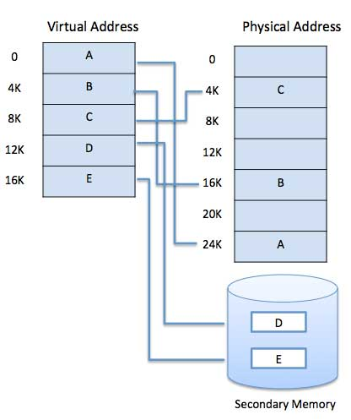

Slide 15
Demand Paging:-
A demand paging system is quite similar to a paging system with swapping where processes reside in secondary memory and pages are loaded only on demand, not in advance. When a context switch occurs, the operating system does not copy any of the old program’s pages out to the disk or any of the new program’s pages into the main memory Instead, it just begins executing the new program after loading the first page and fetches that program’s pages as they are referenced.

Slide 16
While executing a program, if the program references a page which is not available in the main memory because it was swapped out a little ago, the processor treats this invalid memory reference as a page fault and transfers control from the program to the operating system to demand the page back into the memory.
Advantages:-
Following are the advantages of Demand Paging −
*Large virtual memory.
*More efficient use of memory.
*There is no limit on degree of multiprogramming.
Disadvantages:-
*Number of tables and the amount of processor overhead for handling page interrupts are greater than in the case of the simple paged management techniques.

Slide 17
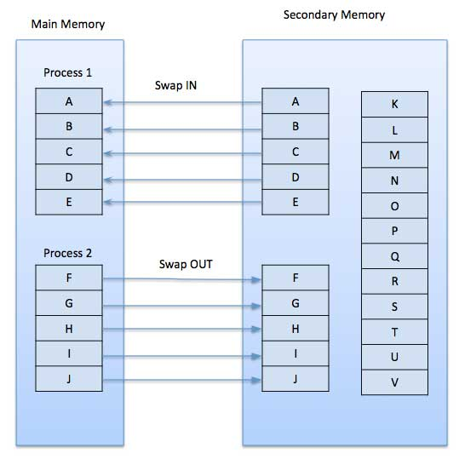

Slide 18
Page Replacement Algorithm:-
Page replacement algorithms are the techniques using which an Operating System decides which memory pages to swap out, write to disk when a page of memory needs to be allocated. Paging happens whenever a page fault occurs and a free page cannot be used for allocation purpose accounting to reason that pages are not available or the number of free pages is lower than required pages.
When the page that was selected for replacement and was paged out, is referenced again, it has to read in from disk, and this requires for I/O completion. This process determines the quality of the page replacement algorithm: the lesser the time waiting for page-ins, the better is the algorithm.

Slide 19
A page replacement algorithm looks at the limited information about accessing the pages provided by hardware, and tries to select which pages should be replaced to minimize the total number of page misses, while balancing it with the costs of primary storage and processor time of the algorithm itself. There are many different page replacement algorithms. We evaluate an algorithm by running it on a particular string of memory reference and computing the number of page faults,

Slide 20
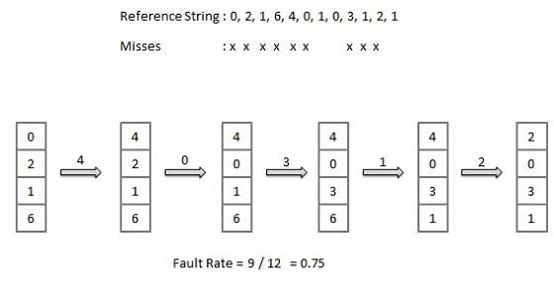
First In First Out (FIFO) algorithm:-
Oldest page in main memory is the one which will be selected for replacement.
Easy to implement, keep a list, replace pages from the tail and add new pages at the head.

Slide 21
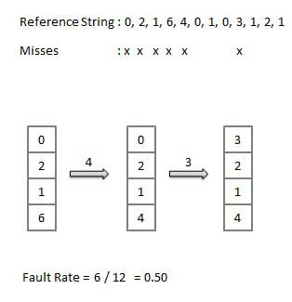
Optimal Page algorithm:-
An optimal page-replacement algorithm has the lowest page-fault rate of all algorithms. An optimal page-replacement algorithm exists, and has been called OPT or MIN.
Replace the page that will not be used for the longest period of time. Use the time when a page is to be used.

Slide 22
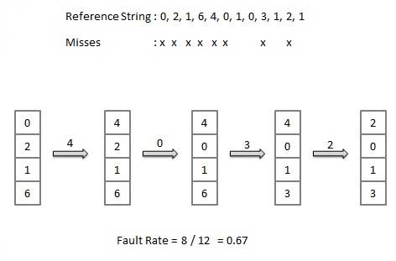
Least Recently Used (LRU) algorithm:-
Page which has not been used for the longest time in main memory is the one which will be selected for replacement.
Easy to implement, keep a list, replace pages by looking back into time.

Slide 23
Page Buffering algorithm:-
To get a process start quickly, keep a pool of free frames.
On page fault, select a page to be replaced.
Write the new page in the frame of free pool, mark the page table and restart the process.
Now write the dirty page out of disk and place the frame holding replaced page in free pool.
Least frequently Used(LFU) algorithm:-
The page with the smallest count is the one which will be selected for replacement.
This algorithm suffers from the situation in which a page is used heavily during the initial phase of a process, but then is never used again.
Most frequently Used(MFU) algorithm:-
This algorithm is based on the argument that the page with the smallest count was probably just brought in and has yet to be used.

Slide 24
Page Fault:-
Page faults dominate more like an error. A page fault will happen if a program tries to access a piece of memory that does not exist in physical memory (main memory). The fault specifies the operating system to trace all data into virtual memory management and then relocate it from secondary memory to its primary memory, such as a hard disk.

Slide 25
A page fault trap occurs if the requested page is not loaded into memory. The page fault primarily causes an exception, which is used to notify the operating system to retrieve the "pages" from virtual memory to continue operation. Once all of the data has been placed into physical memory, the program resumes normal operation. The Page fault process occurs in the background, and thus the user is unaware of it.

Slide 26
Handling page fault:-
Firstly, an internal table for this process to assess whether the reference was valid or invalid memory access.
If the reference becomes invalid, the system process would be terminated. Otherwise, the page will be paged in.
After that, the free-frame list finds the free frame in the system.
Now, the disk operation would be scheduled to get the required page from the disk.
When the I/O operation is completed, the process's page table will be updated with a new frame number, and the invalid bit will be changed. Now, it is a valid page reference.
If any page fault is found, restart these steps from starting.

Slide 27
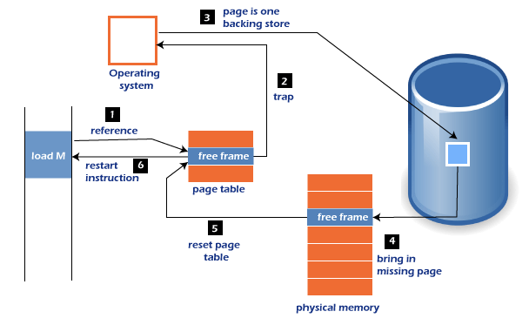

Slide 28
Global Replacement Allocation:-
When a process requires a page that isn't currently in memory, it may put it in and select a frame from the all frames sets, even if another process is already utilizing that frame. In other words, one process may take a frame from another
Advantages:-
Process performance is not hampered, resulting in higher system throughput.
Disadvantages:-
The process itself may not solely control the page fault ratio of a process. The paging behavior of other processes also influences the number of pages in memory for a process.

Slide 29
Local Replacement Allocation:-
When a process requires a page that isn't already in memory, it can bring it in and assign it a frame from its set of allocated frames.
Advantages:-
The paging behavior of a specific process has an effect on the pages in memory and the page fault ratio.
Disadvantages:-
A low priority process may obstruct a high priority process by refusing to share its frames.

Slide 30
Global Vs. Local Replacement Allocation:-
The number of frames assigned to a process does not change using a local replacement strategy. On the other hand, using global replacement, a process can choose only frames granted to other processes and enhance the number of frames allocated.

Slide 31
Thrashing:-
In computer science, thrashing occurs when a computer's virtual memory resources are overused, leading to a constant state of paging and page faults, inhibiting most application-level processing. It causes the performance of the computer to degrade or collapse. The situation can continue indefinitely until the user closes some running applications or the active processes free up additional virtual memory resources.
To know more clearly about thrashing, first, we need to know about page fault and swapping.
Page fault:- We know every program is divided into some pages. A page fault occurs when a program attempts to access data or code in its address space but is not currently located in the system RAM.
Swapping:- Whenever a page fault happens, the operating system will try to fetch that page from secondary memory and try to swap it with one of the pages in RAM. This process is called swapping.
Thrashing is when the page fault and swapping happens very frequently at a higher rate, and then the operating system has to spend more time swapping these pages. This state in the operating system is known as thrashing. Because of thrashing, the CPU utilization is going to be reduced or negligible.

Slide 32
Algorithms during Thrashing:-
Whenever thrashing starts, the operating system tries to apply either the Global page replacement Algorithm or the Local page replacement algorithm.
Global Page Replacement:-
Since global page replacement can bring any page, it tries to bring more pages whenever thrashing is found. But what actually will happen is that no process gets enough frames, and as a result, the thrashing will increase more and more. Therefore, the global page replacement algorithm is not suitable when thrashing happens.
2. Local Page Replacement:-
Unlike the global page replacement algorithm, local page replacement will select pages which only belong to that process. So there is a chance to reduce the thrashing. But it is proven that there are many disadvantages if we use local page replacement. Therefore, local page replacement is just an alternative to global page replacement in a thrashing scenario.

Slide 33
Causes of thrashing:-
If CPU utilization is too low, we increase the degree of multiprogramming by introducing a new system. A global page replacement algorithm is used.
The CPU scheduler sees the decreasing CPU utilization and increases the degree of multiprogramming.
CPU utilization is plotted against the degree of multiprogramming.
As the degree of multiprogramming increases, CPU utilization also increases.
If the degree of multiprogramming is increased further, thrashing sets in, and CPU utilization drops sharply.
So, at this point, to increase CPU utilization and to stop thrashing, we must decrease the degree of multiprogramming.

Slide 34
Techniques to Prevent Thrashing:-
The Local Page replacement is better than the Global Page replacement, but local page replacement has many disadvantages, so it is sometimes not helpful. Therefore below are some other techniques that are used to handle thrashing:
1. Locality Model:-
A locality is a set of pages that are actively used together. The locality model states that as a process executes, it moves from one locality to another. Thus, a program is generally composed of several different localities which may overlap.
For example, when a function is called, it defines a new locality where memory references are made to the function call instructions, local and global variables, etc. Similarly, when the function is exited, the process leaves this locality.

Slide 35
2. Working-Set Model:-
This model is based on the above-stated concept of the Locality Model.
The basic principle states that if we allocate enough frames to a process to accommodate its current locality, it will only fault whenever it moves to some new locality. But if the allocated frames are lesser than the size of the current locality, the process is bound to thrash.
3.Page Fault Frequency:-
The problem associated with thrashing is the high page fault rate, and thus, the concept here is to control the page fault rate.
If the page fault rate is too high, it indicates that the process has too few frames allocated to it. On the contrary, a low page fault rate indicates that the process has too many frames.
Upper and lower limits can be established on the desired page fault rate, as shown in the diagram.
If the page fault rate falls below the lower limit, frames can be removed from the process. Similarly, if the page faults rate exceeds the upper limit, more frames can be allocated to the process.

Slide 36
What is Memory Management :-
In a multiprogramming computer, the operating system resides in a part of memory and the rest is used by multiple processes. The task of subdividing the memory among different processes is called memory management. Memory management is a method in the operating system to manage operations between main memory and disk during process execution. The main aim of memory management is to achieve efficient utilization of memory.
Why Memory Management is required:-
Allocate and de-allocate memory before and after process execution.
To keep track of used memory space by processes.
To minimize fragmentation issues.
To proper utilization of main memory.
To maintain data integrity while executing of process.

Slide 37
Logical and Physical Address Space:-
Logical Address space: An address generated by the CPU is known as a “Logical Address”. It is also known as a Virtual address. Logical address space can be defined as the size of the process. A logical address can be changed.
Physical Address space: An address seen by the memory unit (i.e the one loaded into the memory address register of the memory) is commonly known as a “Physical Address”. A Physical address is also known as a Real address. The set of all physical addresses corresponding to these logical addresses is known as Physical address space. A physical address is computed by MMU. The run-time mapping from virtual to physical addresses is done by a hardware device Memory Management Unit(MMU). The physical address always remains constant.

Slide 38
Swapping :-
When a process is executed it must have resided in memory. Swapping is a process of swapping a process temporarily into a secondary memory from the main memory, which is fast as compared to secondary memory. A swapping allows more processes to be run and can be fit into memory at one time. The main part of swapping is transferred time and the total time is directly proportional to the amount of memory swapped. Swapping is also known as roll-out, roll in, because if a higher priority process arrives and wants service, the memory manager can swap out the lower priority process and then load and execute the higher priority process. After finishing higher priority work, the lower priority process swapped back in memory and continued to the execution process.

Slide 39
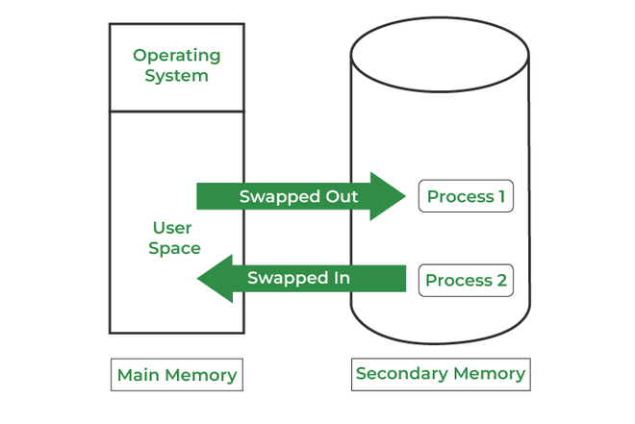

Slide 40
What is address binding in the operating system:-
The Address Binding refers to the mapping of computer instructions and data to physical memory locations. Both logical and physical addresses are used in computer memory. It assigns a physical memory region to a logical pointer by mapping a physical address to a logical address known as a virtual address. It is also a component of computer memory management that the OS performs on behalf of applications that require memory access.
Types of Address Binding in Operating System:-
There are mainly three types of an address binding in the OS. These are as follows:
Compile Time Address Binding
Load Time Address Binding
Execution Time or Dynamic Address Binding

Slide 41
Compile Time Address Binding:-
It is the first type of address binding. It occurs when the compiler is responsible for performing address binding, and the compiler interacts with the operating system to perform the address binding. In other words, when a program is executed, it allocates memory to the system code of the computer. The address binding assigns a logical address to the beginning of the memory segment to store the object code. Memory allocation is a long-term process and may only be modified by recompiling the program.

Slide 42
Load Time Address Binding:-
It is another type of address binding. It is done after loading the program in the memory, and it would be done by the operating system memory manager, i.e., loader. If memory allocation is specified when the program is assigned, no program in its compiled state may ever be transferred from one computer to another. Memory allocations in the executable code may already be in use by another program on the new system. In this case, the logical addresses of the program are not connected to physical addresses until it is applied and loaded into memory.
Execution Time or Dynamic Address Binding:-
Execution time address binding is the most popular type of binding for scripts that aren't compiled because it only applies to variables in the program. When a variable in a program is encountered during the processing of instructions in a script, the program seeks memory space for that variable. The memory would assign the space to that variable until the program sequence finished or unless a specific instruction within the script released the memory address connected to a variable.

